Slide 1
DATA EXTRACTION AND VISUALISATION USING VEGALITE
Presented by: Arushi Bajpai
B.Sc. Economics, Semester-III
Loreto College

Slide 2
INTRODUCTION
This project focuses on extracting data from Power BI report file using Dax Studio and presenting it through clear, interactive visualisations using VegaLite.

Slide 3
FLOW CHART
DATA CLEANING
EXCEL TO DAX STUDIO
EXTRACTING INSIGHTS
VISUALISING
INSIGHTS

Slide 4
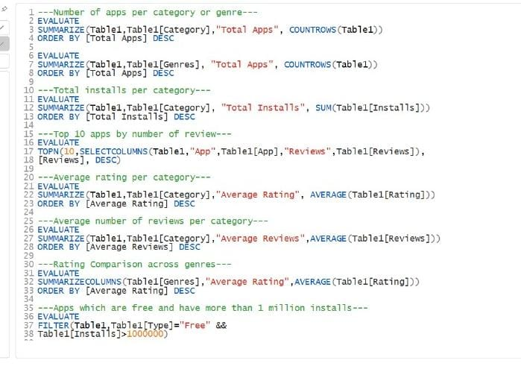
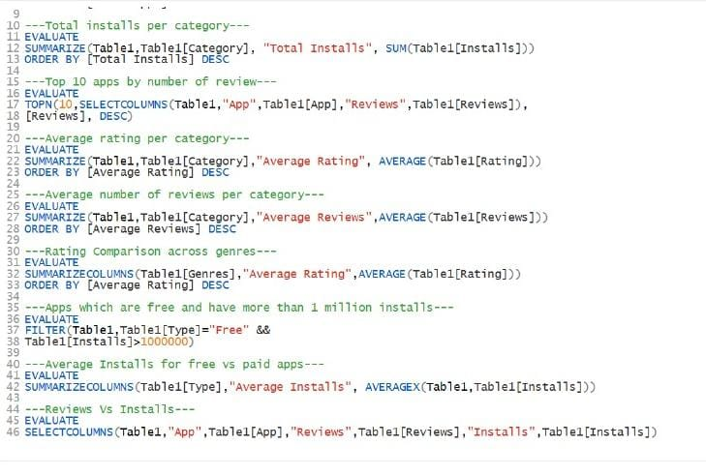
CODES FOR DAX STUDIO

Slide 5
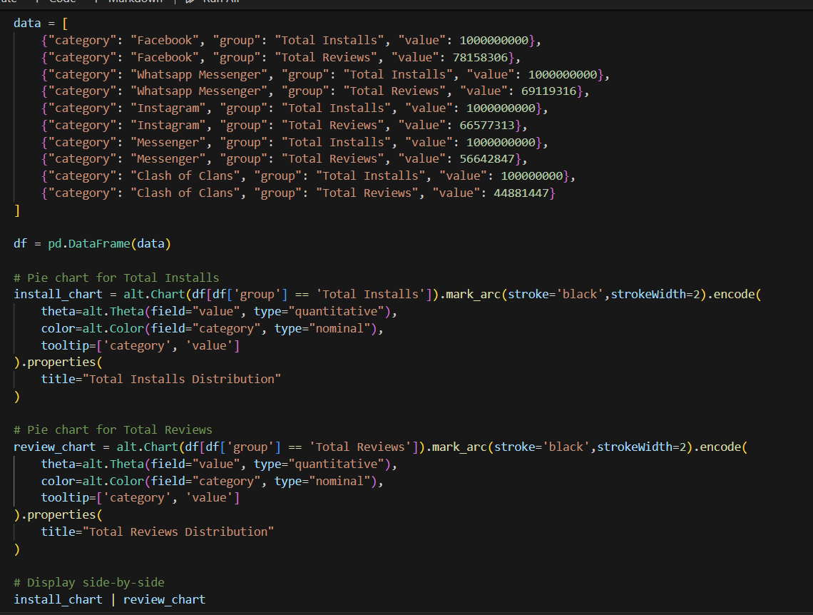
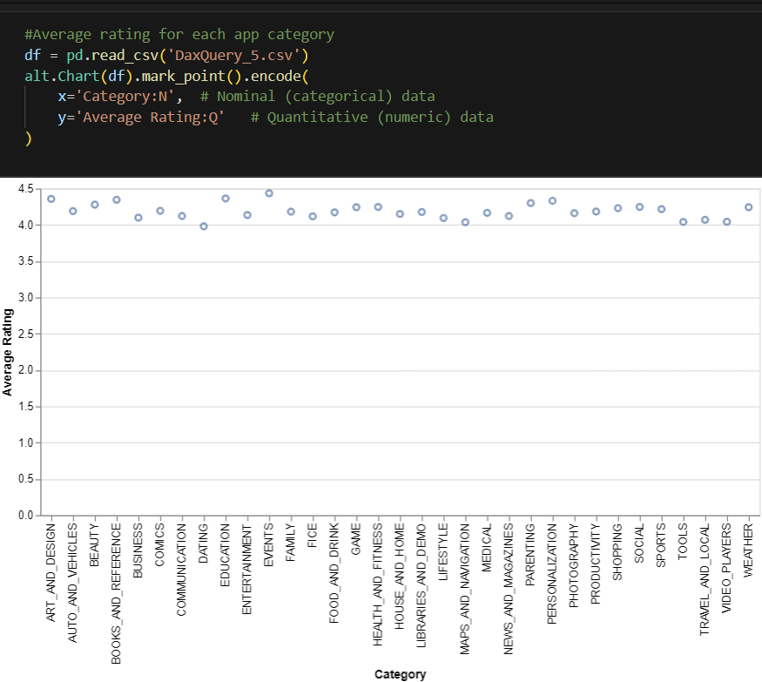
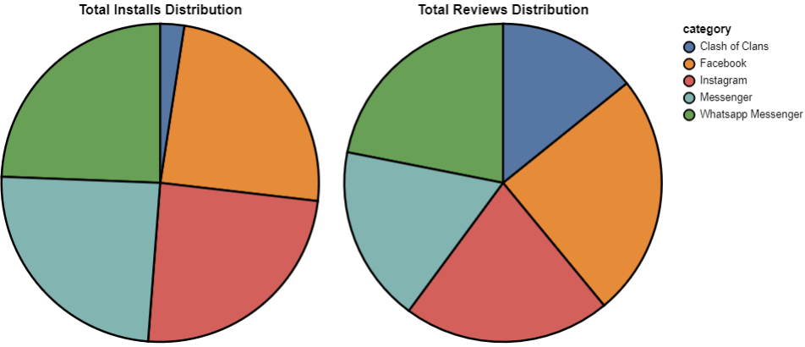
EXAMPLE VISUALISATIONS

Slide 6
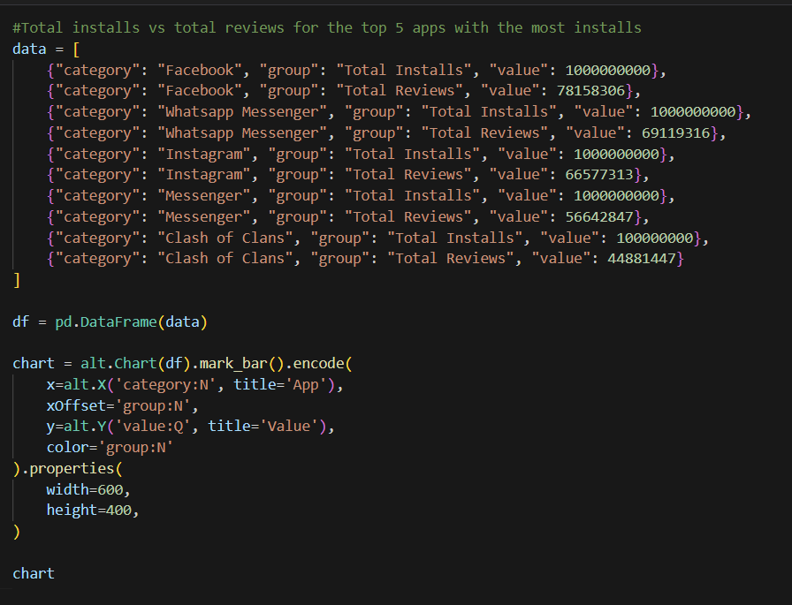
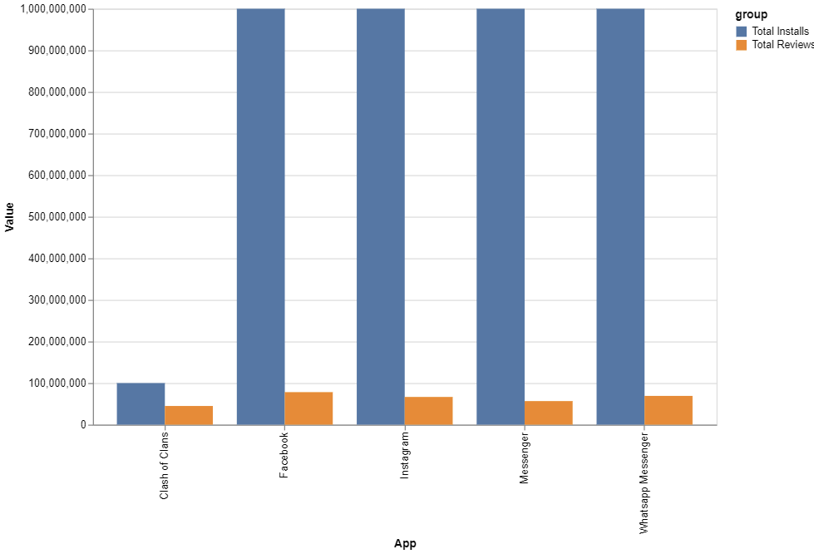

Slide 7
KEY INSIGHTS
This project enhanced my ability to handle complex file structures and prepare raw data for analysis. I developed proficiency in using DAX for querying and generating insights within Power BI. I also applied key data visualization principles to design clear and effective dashboards.

Slide 8
REFERENCES
https://docs.streamlit.io/develop/api-reference/charts/st.vega_lite_chart
https://altair-viz.github.io/user_guide/data.html
https://vega.github.io/vega-lite/examples/#repeat--concatenation
https://docs.streamlit.io/develop/api-reference/charts/st.vega_lite_chart
https://www.kaggle.com/code/faisaljanjua0555/eda-google-play-store-apps/input

Slide 9
THANK YOU!

